Slide 1

Forensics and Auditing
Notes:
Security auditing is a form of auditing that focuses on the security of an organization’s
information system (IS) assets. This function is a key element in computer
security. Security auditing can
• Provide a level of assurance concerning the proper operation of the computer
with respect to security.
• Generate data that can be used in after-the-fact analysis of an attack, whether
successful or unsuccessful.
• Provide a means of assessing inadequacies in the security service.
• Provide data that can be used to define anomalous behavior.
• Maintain a record useful in computer forensics.

Slide 2
Computer Forensics
Computer forensics is the science of attempting to recover evidence on a computer system.
Complex area:
Legal issues heavily weigh in here.
Technical tools are likewise complex, since a chain of evidence must be preserved.
However, much of this boils down to an area called auditing. As a result, we must discuss what audit tools are included (and appropriate) on various systems.
Notes:
Reviewing the functionality suggested by Figures 18.1 and 18.3 , we can develop a
set of requirements for security auditing. The first requirement is event definition .
The security administrator must define the set of events that are subject to audit.
We go into more detail in the next section, but we include here a list suggested in
[CCPS04a]:
• Introduction of objects within the security-related portion of the software into
a subject’s address space
• Deletion of objects
• Distribution or revocation of access rights or capabilities
• Changes to subject or object security attributes
• Policy checks performed by the security software as a result of a request by a subject
• The use of access rights to bypass a policy check
• Use of identification and authentication functions
• Security-related actions taken by an operator and/or authorized user (e.g.,
suppression of a protection mechanism)
• Import/export of data from/to removable media (e.g., printed output, tapes,
disks)

Slide 3
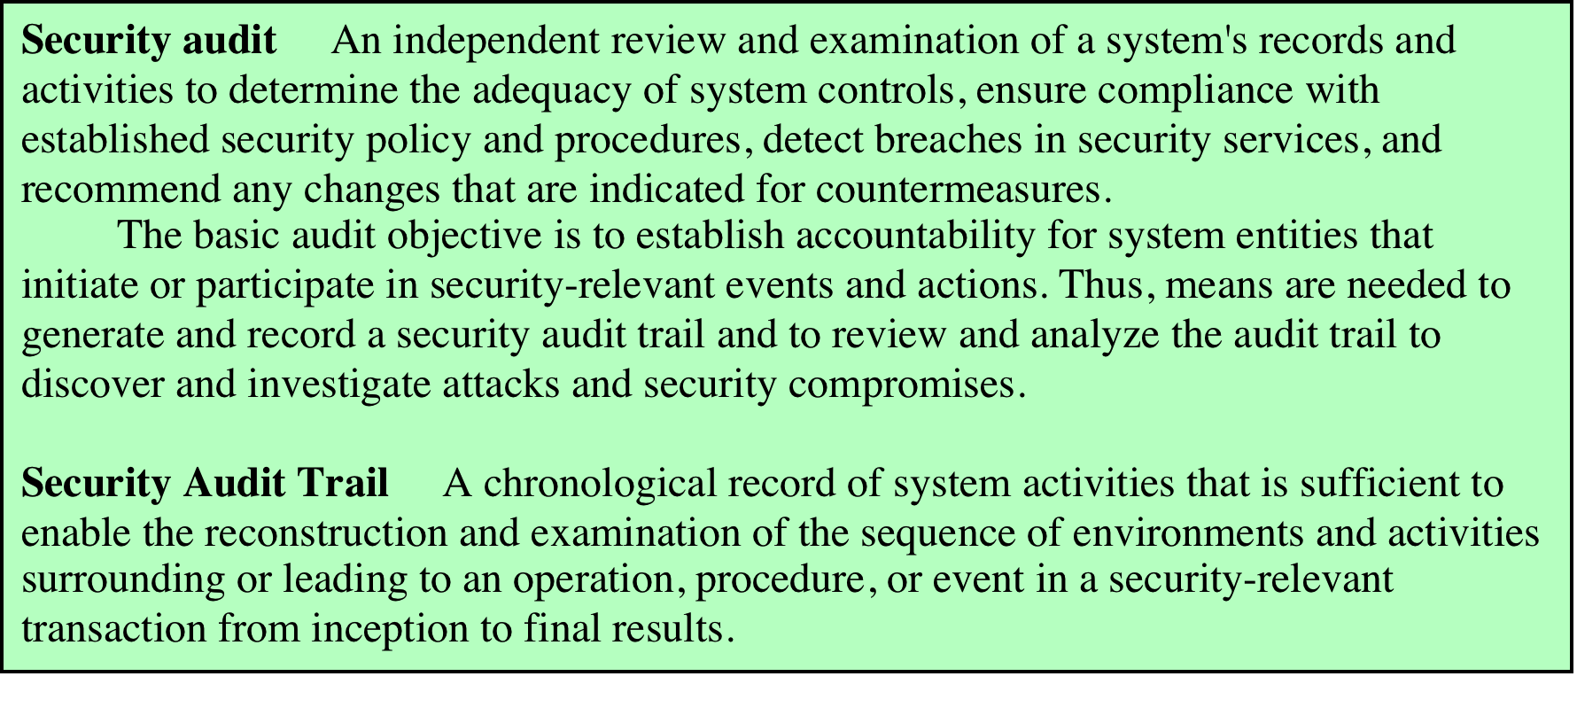
Table 18.1 Security Audit Terminology
RFC 2828
Notes:
Two key concepts are audits and audit trails, defined in Table 18.1 .
The process of generating audit information yields data that may be useful in real
time for intrusion detection; this aspect is discussed in Chapter 8 . In the present chapter,
our concern is with the collection, storage, and analysis of data related to IS security.
We begin with an overall look at the security auditing architecture and how this relates
to the companion activity of intrusion detection. Next, we discuss the various aspects of
audit trails, also known as audit logs. We then discuss the analysis of audit data.

Slide 4
Anatomy of an audit system
Logger: a mechanism to record information. Generally built into the system, but can be tailored by administrator.
Analyzer: Takes a log as input. Result of the analysis may lead either to changes in the data being recorded or to detection of problem/event.
Notifier: Takes output of analyzer and takes appropriate action, such as notifying user or admin.

Slide 5
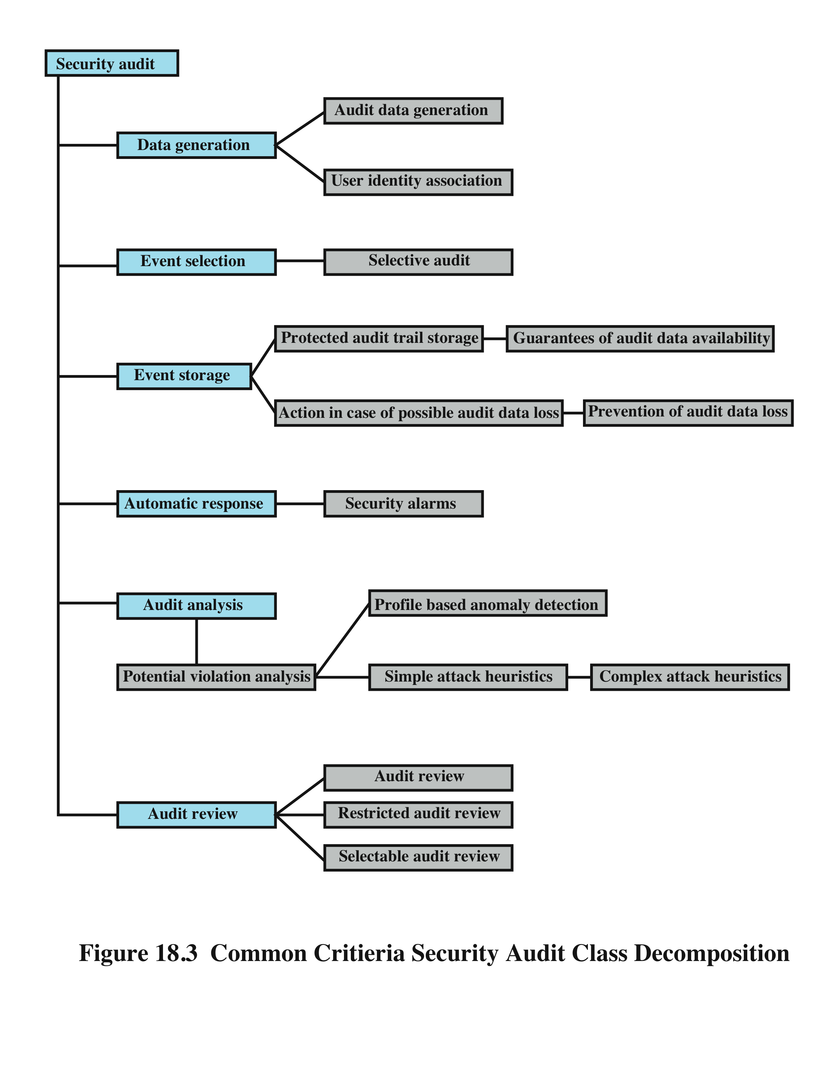
Security Auditing Functions
Notes:
It is useful to look at another breakdown of the security auditing function, developed
as part of the Common Criteria specification [CCPS04a]. Figure 18.3 shows a
breakdown of security auditing into six major areas, each of which has one or more
specific functions:
• Data generation: Identifies the level of auditing, enumerates the types of
auditable events, and identifies the minimum set of audit-related information
provided. This function must also deal with the conflict between security and
privacy and specify for which events the identity of the user associated with an
action is included in the data generated as a result of an event.
• Event selection: Inclusion or exclusion of events from the auditable set. This
allows the system to be configured at different levels of granularity to avoid
the creation of an unwieldy audit trail.
• Event storage: Creation and maintenance of the secure audit trail. The storage
function includes measures to provide availability and to prevent loss of data
from the audit trail.
• Automatic response: Defines reactions taken following detection of events
that are indicative of a potential security violation.
• Audit analysis: Provided via automated mechanisms to analyze system activity
and audit data in search of security violations. This component identifies the
set of auditable events whose occurrence or accumulated occurrence indicates
a potential security violation. For such events, an analysis is done to determine
if a security violation has occurred; this analysis uses anomaly detection and
attack heuristics.
• Audit review: As available to authorized users to assist in audit data review.
The audit review component may include a selectable review function
that provides the ability to perform searches based on a single criterion or
multiple criteria with logical (i.e., and/or) relations, sort audit data, and filter
audit data before audit data are reviewed. Audit review may be restricted to
authorized users.

Slide 6
Event Definition
must define the set of events that are subject to audit
common criteria suggests:
introduction of objects
deletion of objects
distribution or revocation of access rights or capabilities
changes to subject or object security attributes
policy checks performed by the security software
use of access rights to bypass a policy check
use of identification and authentication functions
security-related actions taken by an operator/user
import/export of data from/to removable media
Notes:
Reviewing the functionality suggested by Figures 18.1 and 18.3 , we can develop a
set of requirements for security auditing. The first requirement is event definition .
The security administrator must define the set of events that are subject to audit.
We go into more detail in the next section, but we include here a list suggested in
[CCPS04a]:
• Introduction of objects within the security-related portion of the software into
a subject’s address space
• Deletion of objects
• Distribution or revocation of access rights or capabilities
• Changes to subject or object security attributes
• Policy checks performed by the security software as a result of a request by a subject
• The use of access rights to bypass a policy check
• Use of identification and authentication functions
• Security-related actions taken by an operator and/or authorized user (e.g.,
suppression of a protection mechanism)
• Import/export of data from/to removable media (e.g., printed output, tapes,
disks)

Slide 7
Implementation Guidelines
agree on requirements with management
scope of checks agreed and controlled
checks limited to read-only access to software and data
other access only for isolated copies of system files, then erased or given appropriate protection
resources for performing the checks should be explicitly identified and made available
requirements for special or additional processing should be defined
all access should be monitored and logged
document procedures, requirements, responsibilities
person(s) doing audit independent of activities
Notes:
The ISO standard Code of Practice for Information Security Management
(ISO 27002) provides a useful set of guidelines for implementation of an auditing
capability:
1. Audit requirements should be agreed with appropriate management.
2. The scope of the checks should be agreed and controlled.
3. The checks should be limited to read-only access to software and data.
4. Access other than read-only should only be allowed for isolated copies of
system files, which should be erased when the audit is completed or given
appropriate protection if there is an obligation to keep such files under audit
documentation requirements.
5. Resources for performing the checks should be explicitly identified and made
available.
6. Requirements for special or additional processing should be identified and
agreed.
7. All access should be monitored and logged to produce a reference trail; the
use of time-stamped reference trails should be considered for critical data or
systems.
8. All procedures, requirements, and responsibilities should be documented.
9. The person(s) carrying out the audit should be independent of the activities
audited.

Slide 8
What to Collect
events related to the use of the auditing software
events related to the security mechanisms on the system
events that are collected for use by the various security detection and prevention mechanisms
events related to system management and operation
operating system access
application access for selected applications
remote access
Notes:
The choice of data to collect is determined by a number of requirements. One
issue is the amount of data to collect, which is determined by the range of areas of
interest and by the granularity of data collection. There is a trade-off here between
quantity and efficiency. The more data are collected, the greater is the performance
penalty on the system. Larger amounts of data may also unnecessarily burden the
various algorithms used to examine and analyze the data. Further, the presence of
large amounts of data creates a temptation to generate security reports excessive in
number or length.
With these cautions in mind, the first order of business in security audit trail
design is the selection of data items to capture. These may include
• Events related to the use of the auditing software (i.e., all the components of
Figure 18.1 ).
• Events related to the security mechanisms on the system.
• Any events that are collected for use by the various security detection and
prevention mechanisms. These include items relevant to intrusion detection
(e.g., Table 8.2 ) and items related to firewall operation (e.g., Tables 9.3 and 9.4 ).
• Events related to system management and operation.
• Operating system access (e.g., via system calls).
• Application access for selected applications.
• Remote access.

Slide 9
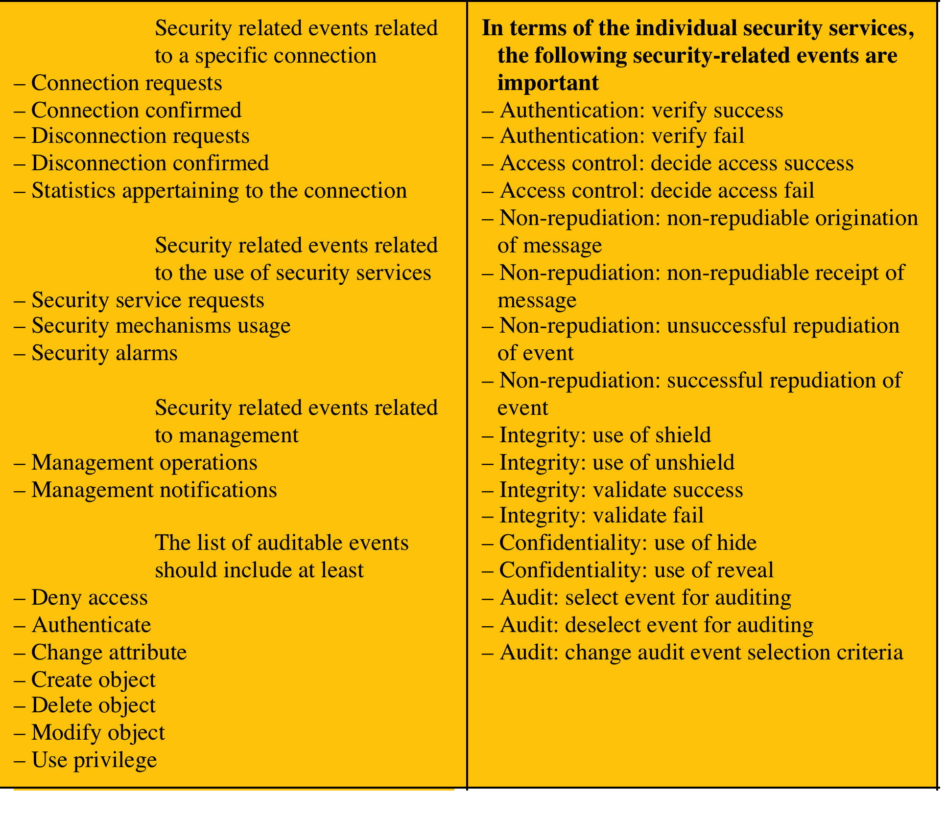
Table 18.2 Auditable Items Suggested in X.816
Notes:
One example is a suggested list of auditable items in X.816, shown in Table 18.2 .
The standard points out that both normal and abnormal conditions may need to be
audited; for instance, each connection request, such as a TCP connection request, may
be a subject for a security audit trail record, whether or not the request was abnormal
and irrespective of whether the request was accepted or not. This is an important
point. Data collection for auditing goes beyond the need to generate security alarms
or to provide input to a firewall module. Data representing behavior that does not
trigger an alarm can be used to identify normal versus abnormal usage patterns and
thus serve as input to intrusion detection analysis. Also, in the event of an attack,
an analysis of all the activity on a system may be needed to diagnose the attack and
arrive at suitable countermeasures for the future.

Slide 10
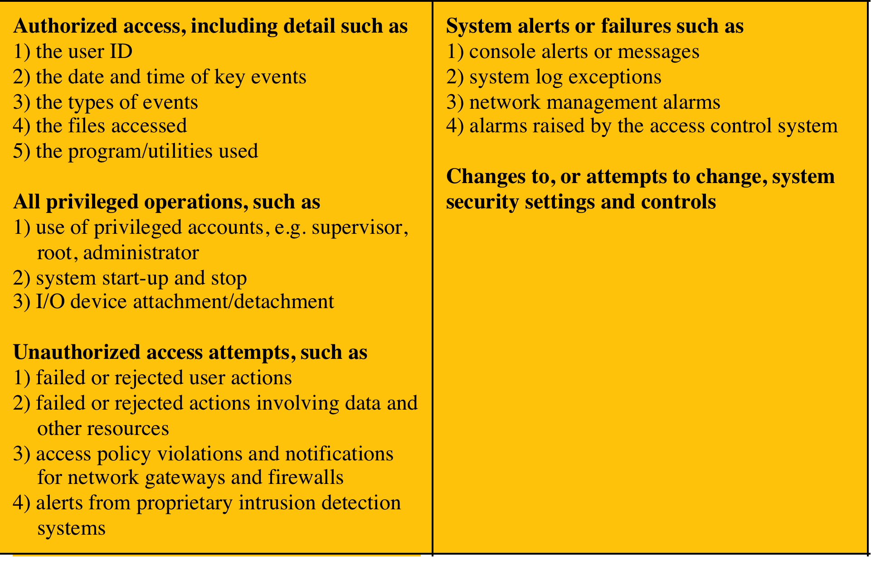
Monitoring Areas Suggested in ISO 27002
Notes:
Another useful list of auditable events ( Table 18.3 ) is contained in ISO 27002.
As with X.816, the ISO standard details both authorized and unauthorized events,
as well as events affecting the security functions of the system.
As the security administrator designs an audit data collection policy, it is
useful to organize the audit trail into categories for purposes of choosing data items
to collect. In what follows, we look at useful categories for audit trail design.

Slide 11
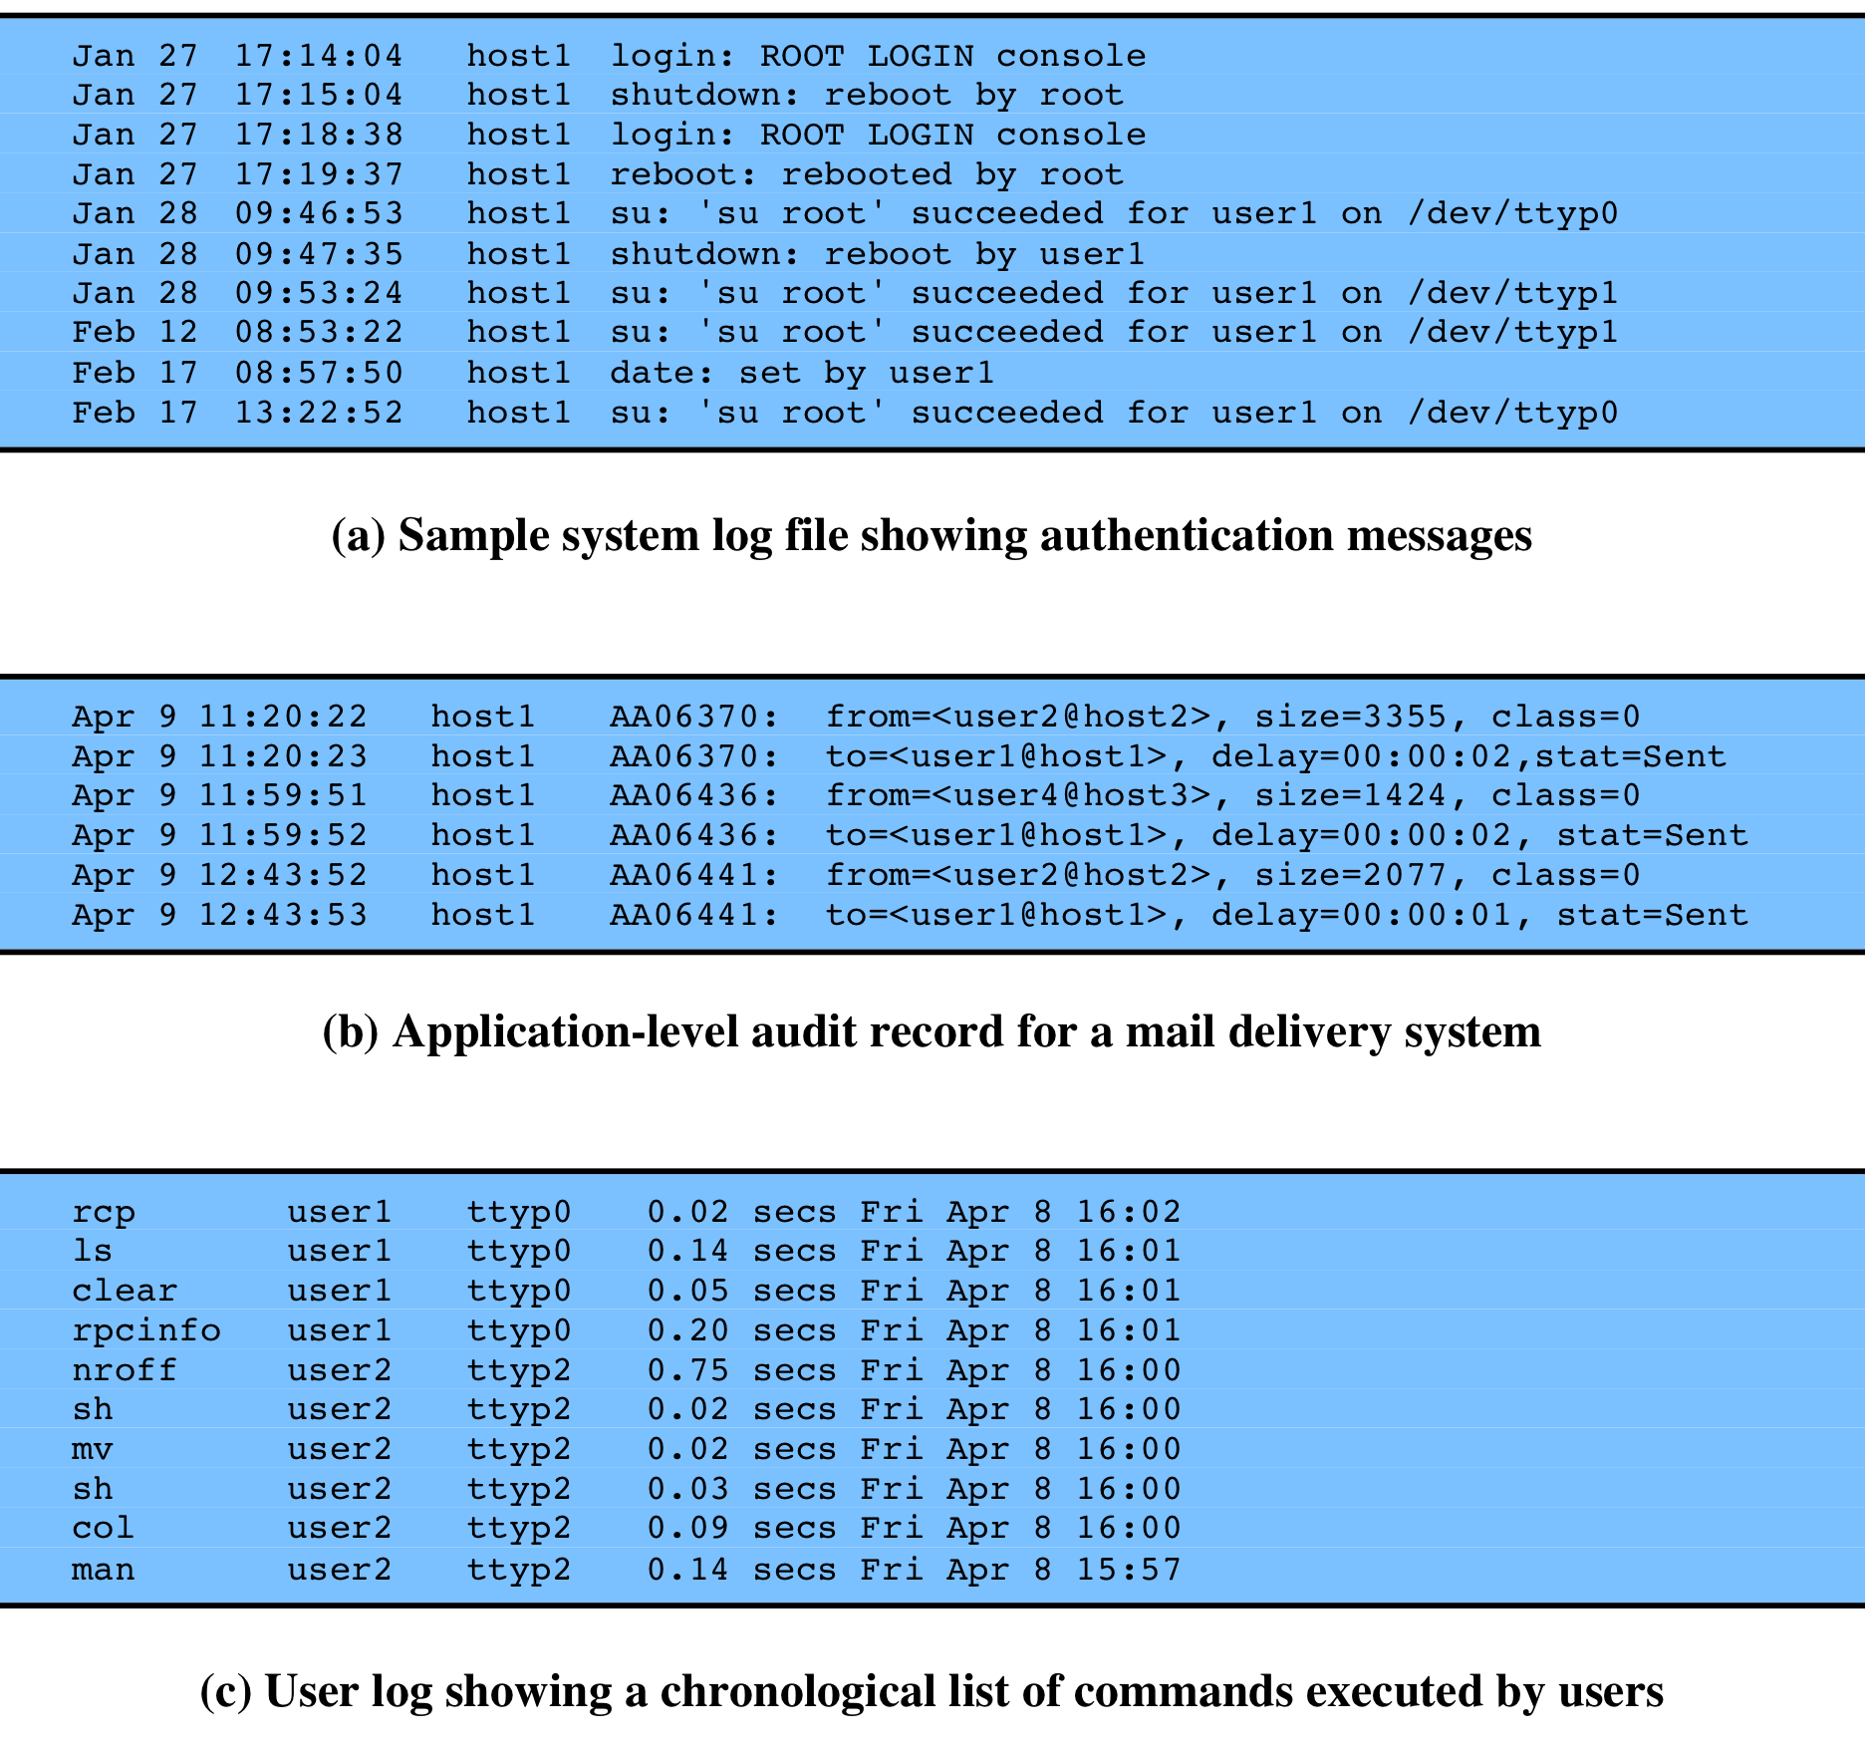
Figure 18.4 - Examples of Audit Trails
figure 18.4a is an example of a system-level audit trail on a UNIX system
figure 18.4b is an example of an application-level audit trail for a mail delivery system
figure 18.4c is an example of a user-level audit trail on a UNIX system
Notes:
System-level audit trails are generally used to
monitor and optimize system performance but can serve a security audit function
as well. The system enforces certain aspects of security policy, such as access to the
system itself. A system-level audit trail should capture data such as login attempts,
both successful and unsuccessful, devices used, and OS functions performed. Other
system-level functions may be of interest for auditing, such as system operation and
network performance indicators.
Figure 18.4a , from [NIST95], is an example of a system-level audit trail on
a UNIX system. The shutdown command terminates all processes and takes the
system down to single-user mode. The su command creates a UNIX shell.
Application-level audit trails may be used to
detect security violations within an application or to detect flaws in the application’s
interaction with the system. For critical applications, or those that deal with sensitive
data, an application-level audit trail can provide the desired level of detail to assess
security threats and impacts. For example, for an e-mail application, an audit trail
can record sender and receiver, message size, and types of attachments. An audit
trail for a database interaction using SQL (Structured Query Language) queries can
record the user, type of transaction, and even individual tables, rows, columns, or
data items accessed.
Figure 18.4b is an example of an application-level audit trail for a mail delivery
system.
A user-level audit trail traces the activity of individual
users over time. It can be used to hold a user accountable for his or her actions. Such
audit trails are also useful as input to an analysis program that attempts to define
normal versus anomalous behavior.
A user-level audit trail can record user interactions with the system,
such as commands issued, identification and authentication attempts, and
files and resources accessed. The audit trail can also capture the user’s use of
applications.
Figure 18.4c is an example of a user-level audit trail on a UNIX system.

Slide 12
Physical Access Audit Trails
generated by equipment that controls physical access
card-key systems, alarm systems
sent to central host for analysis and storage
data of interest:
date/time/location/user of access attempt
both valid and invalid access attempts
attempts to add/modify/delete physical access privileges
may send violation messages to personnel
Notes:
Audit trails can be generated by equipment
that controls physical access and then transmitted to a central host for subsequent
storage and analysis. Examples are card-key systems and alarm systems. [NIST95]
lists the following as examples of the type of data of interest:
• The date and time the access was attempted or made should be logged,
as should the gate or door through which the access was attempted or
made, and the individual (or user ID) making the attempt to access the gate
or door.
• Invalid attempts should be monitored and logged by non-computer audit trails
just as they are for computer system audit trails. Management should be made
aware if someone attempts to gain access during unauthorized hours.
• Logged information should also include attempts to add, modify, or delete
physical access privileges (e.g., granting a new employee access to the building
or granting transferred employees access to their new office [and, of course,
deleting their old access, as applicable]).
• As with system and application audit trails, auditing of non-computer functions
can be implemented to send messages to security personnel indicating valid or
invalid attempts to gain access to controlled spaces. In order not to desensitize
a guard or monitor, all access should not result in messages being sent to a
screen. Only exceptions, such as failed access attempts, should be highlighted
to those monitoring access.

Slide 13
Protecting Audit Trail Data
read/write file on host
easy, least resource intensive, instant access
vulnerable to attack by intruder
write-once/read-many device
more secure but less convenient
need steady supply of recordable media
access may be delayed and not available immediately
write-only device
provides paper trail
impractical for capturing detailed audit data on large or networked systems
useful when a permanent, immediately available log is required
must protect both integrity and confidentiality
encryption, digital signatures, access controls
Notes:
RFC 2196 ( Site Security Handbook ) lists three alternatives for storing audit
records:
• Read/write file on a host
• Write-once/read-many device (e.g., CD-ROM or DVD-ROM)
• Write-only device (e.g., a line printer)
File system logging is relatively easy to configure and is the least resource
intensive. Records can be accessed instantly, which is useful for countering an
ongoing attack. However, this approach is highly vulnerable. If an attacker gains
privileged access to a system, then the audit trail is vulnerable to modification or
deletion.
A CD-ROM or similar storage method is far more secure but less convenient.
A steady supply of recordable media is needed. Access may be delayed and not
available immediately.
Printed logs do provide a paper trail, but are impractical for capturing detailed
audit data on large systems or networked systems. RFC 2196 suggests that the paper
log can be useful when a permanent, immediately available log is required even
with a system crash.
Protection of the audit trail involves both integrity and confidentiality. Integrity
is particularly important because an intruder may attempt to remove evidence of
the intrusion by altering the audit trail. For file system logging, perhaps the best way
to ensure integrity is the digital signature. Write-once devices, such as CD-ROM or
paper, automatically provide integrity. Strong access control is another measure to
provide integrity.
Confidentiality is important if the audit trail contains user information that
is sensitive and should not be disclosed to all users, such as information about
changes in a salary or pay grade status. Strong access control helps in this regard.
An effective measure is symmetric encryption (e.g., using AES [Advanced
Encryption Standard] or triple DES [Data Encryption Standard]). The secret key
must be protected and only available to the audit trail software and subsequent
audit analysis software.
Note that integrity and confidentiality measures protect audit trail data not
only in local storage but also during transmission to a central repository.

Slide 14
Implementing Logging
foundation of security auditing facility is the initial capture of the audit data
software must include hooks (capture points) that trigger data collection and storage as preselected events occur
dependent on the nature of the software
varies depending on operating system and applications involved
Notes:
The foundation of a security auditing facility is the initial capture of the audit
data. This requires that the software include hooks, or capture points, that trigger
the collection and storage of data as preselected events occur. Such an audit
collection or logging function is dependent on the nature of the software and will
vary depending on the underlying operating system and the applications involved.
In this section, we look at approaches to implementing the logging function for
system-level and user-level audit trails on the one hand and application-level audit
trails on the other.

Slide 15
Windows Event Log
event is an entity that describes some interesting occurrence
contains:
a numeric identification code
a set of attributes
optional user-supplied data
three types of event logs:
system: system related apps and drivers
application: user-level apps
security: Windows LSA
Notes:
An event in Windows Event Log is an entity that describes
some interesting occurrence in a computer system. Events contain a numeric
identification code, a set of attributes (task, opcode, level, version, and keywords),
and optional user-supplied data. Windows is equipped with three types of event logs:
• System event log: Used by applications running under system service accounts
(installed system services), drivers, or a component or application that has
events that relate to the health of the computer system.
• Application event log: Events for all user-level applications. This log is not
secured and it is open to any applications. Applications that log extensive
information should define an application-specific log.
• Security event log: The Windows Audit Log. This event log is for exclusive use
of the Windows Local Security Authority. User events may appear as audits if
supported by the underlying application.

Slide 16
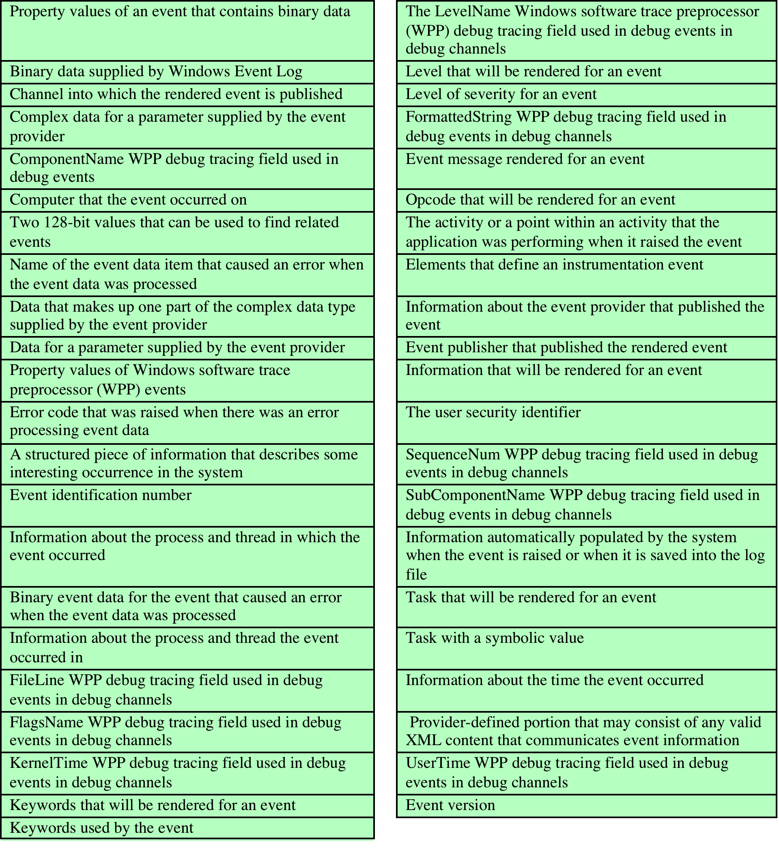
Windows Event Schema Elements
Notes:
Table 18.4 lists the items of information stored for each event.

Slide 17
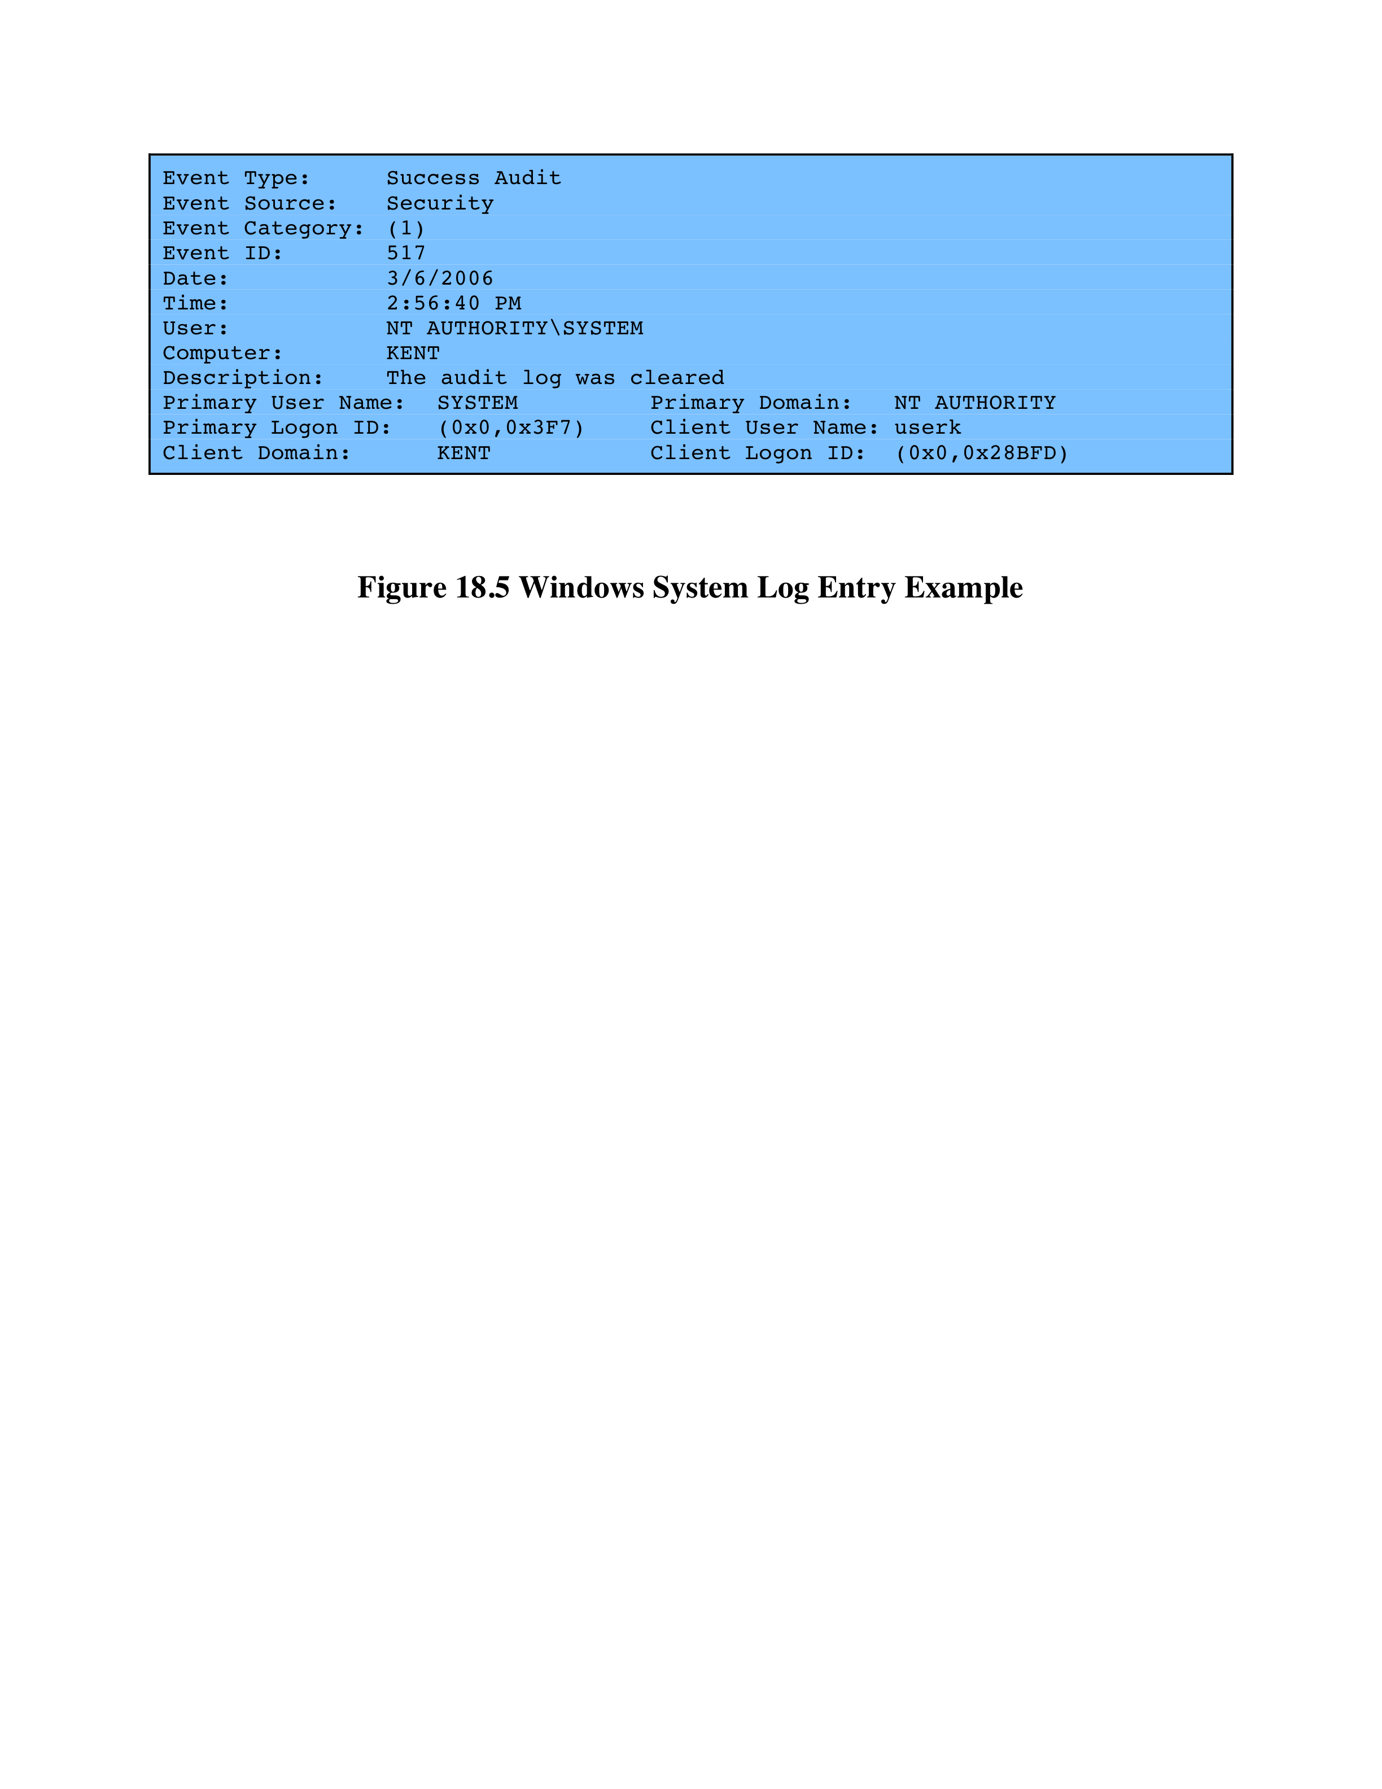
Windows System Log Example
Notes:
Figure 18.5 is an example of data exported from a Windows system event log.

Slide 18
Windows Event Categories
account logon events
account management
directory service access
logon events
object access
policy changes
privilege use
Notes:
Windows allows the system user to enable auditing in nine different
categories:
• Account logon events: User authentication activity from the perspective of
the system that validated the attempt. Examples: authentication granted;
authentication ticket request failed; account mapped for logon; account
could not be mapped for logon. Individual actions in this category are not particularly instructive, but large numbers of failures may indicate scanning
activity, brute-force attacks on individual accounts, or the propagation of
automated exploits.
• Account management: Administrative activity related to the creation,
management, and deletion of individual accounts and user groups. Examples:
user account created; change password attempt; user account deleted; security
enabled global group member added; domain policy changed.
• Directory service access: User-level access to any Active Directory object that
has a System Access Control List defined. An SACL creates a set of users and
user groups for which granular auditing is required.
• Logon events: User authentication activity, either to a local machine or over
a network, from the system that originated the activity. Examples: successful
user logon; logon failure, unknown username, or bad password; logon failure,
because account is disabled; logon failure, because account has expired; logon
failure, user not allowed to logon at this computer; user logoff; logon failure,
account locked out.
• Object access: User-level access to file system and registry objects that have
System Access Control Lists defined. Provides a relatively easy way to track
read access, as well as changes, to sensitive files, integrated with the operating
system. Examples: object open; object deleted.
• Policy changes: Administrative changes to the access policies, audit configuration,
and other system-level settings. Examples: user right assigned; new
trusted domain; audit policy changed.
• Privilege use: Windows incorporates the concept of a user right, granular permission
to perform a particular task. If you enable privilege use auditing, you record all
instances of users exercising their access to particular system functions (creating
objects, debugging executable code, or backing up the system). Examples: specified
privileges were added to a user’s access token (during logon); a user attempted to
perform a privileged system service operation.
• Process tracking: Generates detailed audit information when processes
start and finish, programs are activated, or objects are accessed indirectly.
Examples: new process was created; process exited; auditable data
was protected; auditable data was unprotected; user attempted to install a
service.
• System events: Records information on events that affect the availability and
integrity of the system, including boot messages and the system shutdown
message. Examples: system is starting; Windows is shutting down; resource
exhaustion in the logging subsystem; some audits lost; audit log cleared.

Slide 19
UNIX Syslog
UNIX's general-purpose logging mechanism
found on all UNIX / Linux variants
elements:
syslog()
API referenced by several standard system utilities and available to application programs
logger
command used to add single-line entries to the system log
/etc/syslog.conf
configuration file used to control the logging and routing of system log events
syslogd
daemon to receive/route log events
Notes:
Syslog is UNIX’s general-purpose logging mechanism found on all UNIX
variants and Linux. It consists of the following elements:
• syslog() : An application program interface (API) referenced by several
standard system utilities and available to application programs
• logger: A UNIX command used to add single-line entries to the system log
• /etc/syslog.conf: The configuration file used to control the logging and
routing of system log events
• syslogd: The system daemon used to receive and route system log events
from syslog() calls and logger commands.
Different UNIX implementations will have different variants of the syslog
facility, and there are no uniform system log formats across systems. Chapter 25
examines the Linux syslog facility. Here, we provide a brief overview of some
syslog-related functions and look at the syslog protocol.

Slide 20
Syslog Service
basic service provides:
a means of capturing relevant events
a storage facility
a protocol for transmitting syslog messages from other machines to a central machine that acts as a syslog server
extra add-on features may include:
robust filtering
log analysis
event response
alternative message formats
log file encryption
database storage
rate limiting
Notes:
The basic service offered by UNIX syslog is a means of capturing relevant events,
a storage facility, and a protocol for transmitting syslog messages from other machines
to a central machine that acts as a syslog server. In addition to these basic functions,
other services are available, often as third-party packages and in some cases as built-in
modules. [KENT06] lists the following as being the most common extra features:
• Robust filtering: Original syslog implementations allowed messages to be
handled differently based on their facility and priority only; no finer-grained
filtering was permitted. Some current syslog implementations offer more
robust filtering capabilities, such as handling messages differently based
on the host or program that generated a message, or a regular expression
matching content in the body of a message. Some implementations also
allow multiple filters to be applied to a single message, which provides more
complex filtering capabilities.
• Log analysis: Originally, syslog servers did not perform any analysis of log data;
they simply provided a framework for log data to be recorded and transmitted.
Administrators could use separate add-on programs for analyzing syslog data.
Some syslog implementations now have limited log analysis capabilities built-in,
such as the ability to correlate multiple log entries.
• Event response: Some syslog implementations can initiate actions when certain
events are detected. Examples of actions include sending SNMP traps, alerting
administrators through pages or e-mails, and launching a separate program or
script. It is also possible to create a new syslog message that indicates that a
certain event was detected.
• Alternative message formats: Some syslog implementations can accept data
in non-syslog formats, such as SNMP traps. This can be helpful for getting
security event data from hosts that do not support syslog and cannot be
modified to do so.
• Log file encryption: Some syslog implementations can be configured to encrypt
rotated log files automatically, protecting their confidentiality. This can also
be accomplished through the use of OS or third-party encryption programs.
• Database storage for logs: Some implementations can store log entries in both
traditional syslog files and a database. Having the log entries in a database
format can be very helpful for subsequent log analysis.
• Rate limiting: Some implementations can limit the number of syslog messages
or TCP connections from a particular source during a certain period of time.
This is useful in preventing a denial of service for the syslog server and the
loss of syslog messages from other sources. Because this technique is designed
to cause the loss of messages from a source that is overwhelming the syslog
server, it can cause some log data to be lost during an adverse event that
generates an unusually large number of messages.

Slide 21
Syslog Protocol
a transport allowing hosts to send IP event notification messages to syslog servers
provides a very general message format
allowing processes and applications to use suitable conventions for their logged events
common version of the syslog protocol was originally developed on the University of California Berkeley Software Distribution (BSD) UNIX/TCP/IP system implementations
messages in the BSD syslog format consist of:
PRI - facilities / severity code
header – timestamp and hostname/IP address
Msg - program name and content
Notes:
The syslog protocol provides a transport to allow a machine to send event
notification messages across IP networks to event message collectors—also
known as syslog servers. Within a system, we can view the process of capturing
and recording events in terms of various applications and system facilities sending
messages to syslogd for storage in the system log. Because each process, application,
and UNIX OS implementation may have different formatting conventions
for logged events, the syslog protocol provides only a very general message format
for transmission between systems. A common version of the syslog protocol was
originally developed on the University of California Berkeley Software Distribution
(BSD) UNIX/TCP/IP system implementations. This version is documented in RFC
3164, The BSD Syslog Protocol . Subsequently, IETF issued RFC 5424, The Syslog
Protocol , which is intended to be an Internet standard and which differs in some
details from the BSD version. In what follows, we describe the BSD version.
Messages in the BSD syslog format consist of three parts:
• PRI: Consists of a code that represents the Facilities and Severity values of the
message, described subsequently.
• Header: Contains a timestamp and an indication of the hostname or IP address
of the device.
• Msg: Consists of two fields: The TAG field is the name of the program or
process that generated the message; the CONTENT contains the details of the
message. The Msg part has traditionally been a free-form message of printable
characters that gives some detailed information of the event.

Slide 22
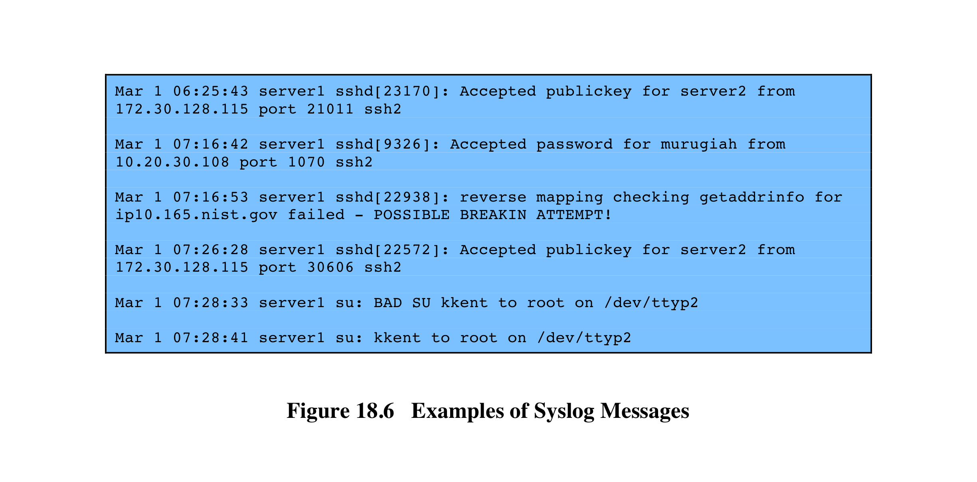
Syslog Examples
Notes:
Figure 18.6 shows several examples of syslog messages, excluding the
PRI part.

Slide 23
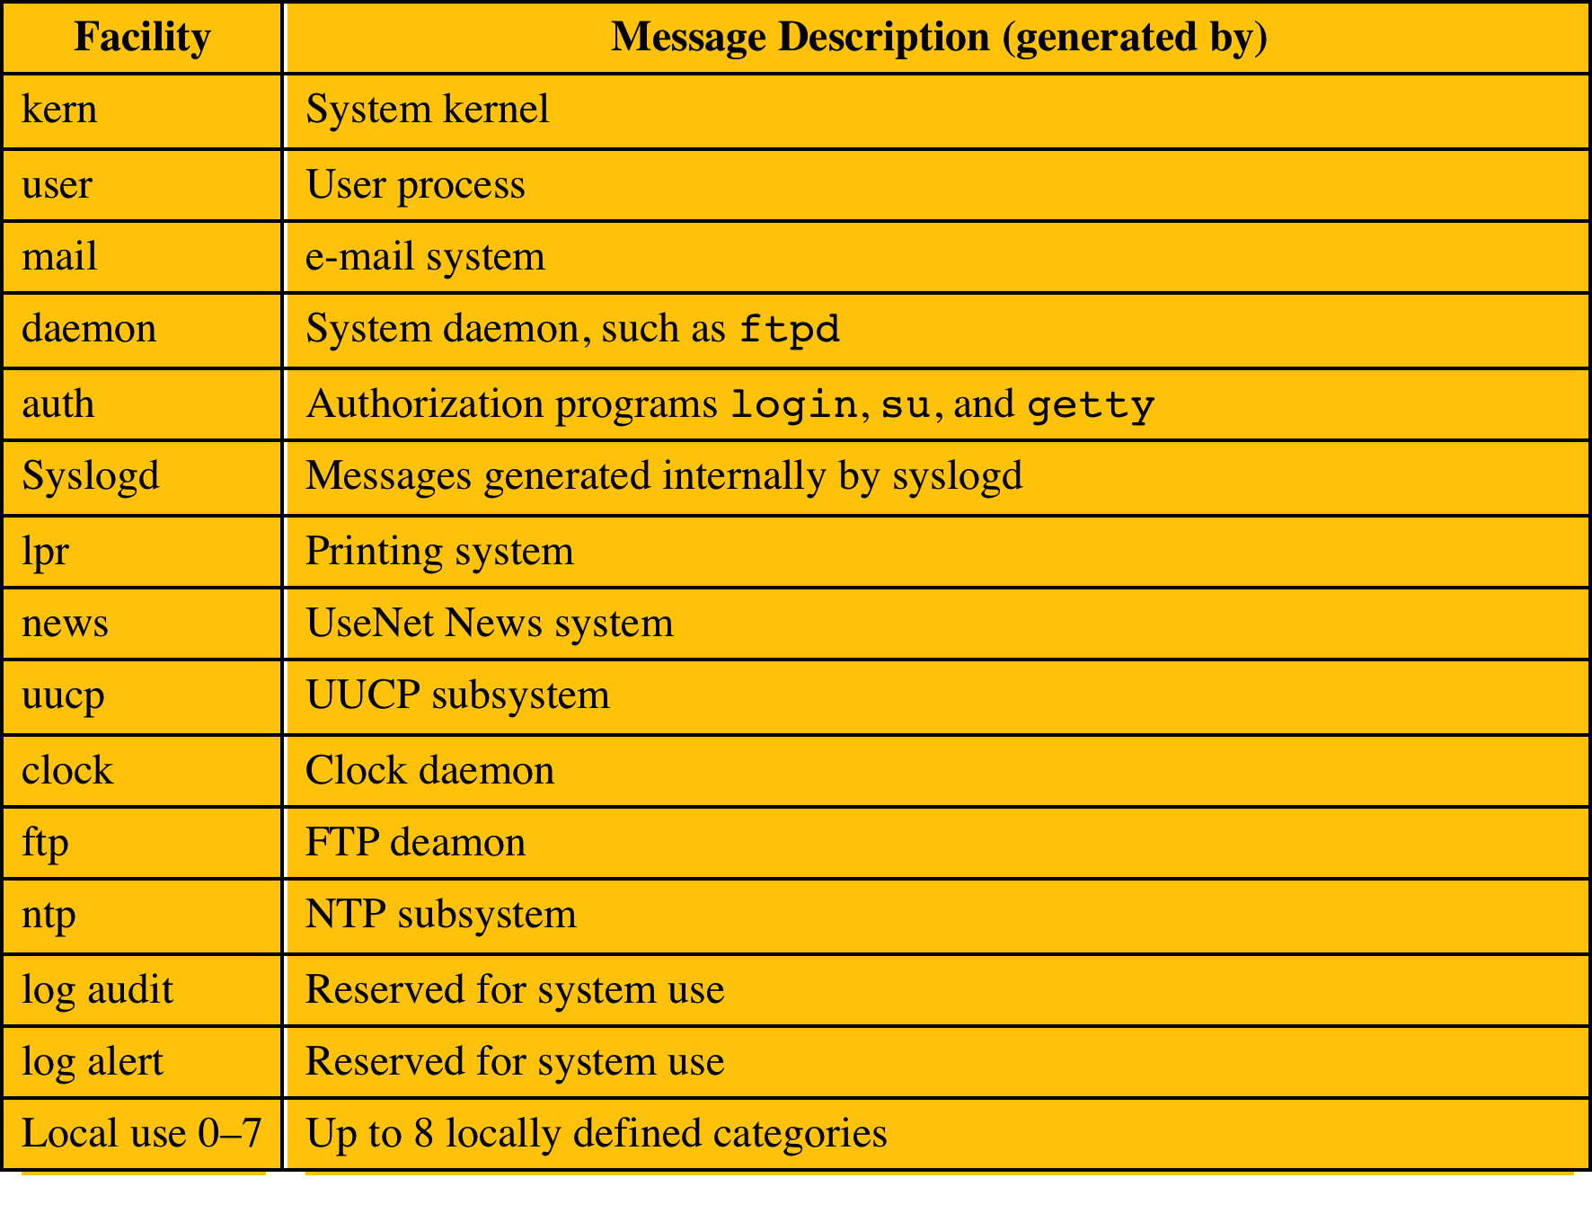
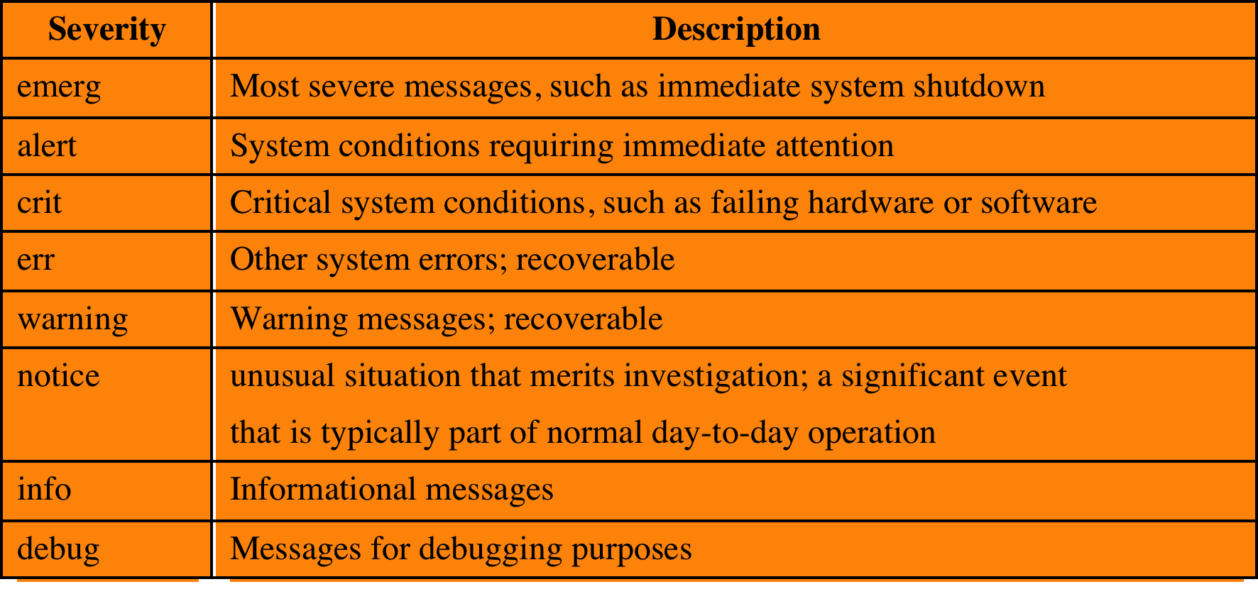
Syslog Facilities and Severity Levels
(a) Syslog Facilities
(b) Syslog Severity Levels
Notes:
All messages sent to syslogd have a facility and a severity ( Table 18.5 ).
The facility identifies the application or system component that generates the
message. The severity, or message level, indicates the relative severity of the
message and can be used for some rudimentary filtering.

Slide 24
Logging at Application Level
privileged applications present security issues
may not be captured by system/user-level audit data
constitute a large percentage of reported vulnerabilities
vulnerabilities exploited:
lack of dynamic checks on input data
errors in application logic
may be necessary to capture behavior of application beyond its access to system services and file systems
two approaches to collecting audit data:
interposable libraries
dynamic binary rewriting
Notes:
Applications, especially applications with a certain level of privilege, present
security problems that may not be captured by system-level or user-level auditing
data. Application-level vulnerabilities constitute a large percentage of reported
vulnerabilities on security mailing lists. One type of vulnerability that can be
exploited is the all-too-frequent lack of dynamic checks on input data, which
make possible buffer overflow (see Chapter 10 ) and format string attacks. Other
vulnerabilities exploit errors in application logic. For example, a privileged application
may be designed to read and print a specific file. An error in the application
might allow an attacker to exploit an unexpected interaction with the shell environment
to force the application to read and print a different file, which would result in
a security compromise.
Auditing at the system level does not provide the level of detail to catch
application logic error behavior. Further, intrusion detection systems look for
attack signatures or anomalous behavior that would fail to appear with attacks
based on application logic errors. For both detection and auditing purposes, it
may be necessary to capture in detail the behavior of an application, beyond
its access to system services and file systems. The information needed to detect
application-level attacks may be missing or too difficult to extract from the
low-level information included in system call traces and in the audit records
produced by the operating system.
In the remainder of this section, we examine two approaches to collecting
audit data from applications: interposable libraries and dynamic binary rewriting.

Slide 25
Interposable Libraries
allows the generation of audit data without needing to recompile either the system libraries or the application
audit data can be generated without changing the system’s shared libraries or needing access to the source code for the executable
exploits the use of dynamic libraries in UNIX
statically linked libraries
a separate copy of the linked library function is loaded into the program’s virtual memory
statically linked shared libraries
referenced shared object is incorporated into the target executable at link time by the link loader
each object is assigned a fixed virtual address
link loader connects external referenced objects by assigning their virtual addresses when the executable is created
dynamically linked shared libraries
the linking to shared library routines is deferred until load time
if changes are made to the library prior to load time any program that references the library is unaffected
Notes:
A technique described in [KUPE99] and [KUPE04] provides for application-level
auditing by creating new procedures that intercept calls to shared library functions
in order to instrument the activity. Interposition allows the generation of audit
data without needing to recompile either the system libraries or the application of
interest. Thus, audit data can be generated without changing the system’s shared
libraries or needing access to the source code for the executable on which the
interposition is to be performed. This approach can be used on any UNIX or Linux
variant and on some other operating systems.
The technique exploits the use of dynamic libraries in UNIX. Before examining
the technique, we provide a brief background on shared libraries.
The OS includes hundreds of C library functions in archive
libraries. Each library consists of a set of variables and functions that are compiled
and linked together. The linking function resolves all memory references to data
and program code within the library, generating logical, or relative, addresses.
A function can be linked into an executable program, on demand, at compilation.
If a function is not part of the program code, the link loader searches a list of libraries
and links the desired object into the target executable. On loading, a separate copy
of the linked library function is loaded into the program’s virtual memory. This
scheme is referred to as statically linked libraries .
A more flexible scheme, first introduced with UNIX System V Release 3, is
the use of statically linked shared libraries . As with statically linked libraries, the
referenced shared object is incorporated into the target executable at link time by
the link loader. However, each object in a statically linked shared library is assigned
a fixed virtual address. The link loader connects external referenced objects to
their definition in the library by assigning their virtual addresses when the executable
is created. Thus, only a single copy of each library function exists. Further, the
function can be modified and remains in its fixed virtual address. Only the object
needs to be recompiled, not the executable programs that reference it. However,
the modification generally must be minor; the changes must be made in such a way
that the start address and the address of any variables, constants, or program labels
in the code are not changed.
UNIX System V Release 4 introduced the concept of dynamically linked
shared libraries . With dynamically linked libraries, the linking to shared library
routines is deferred until load time. At this time, the desired library contents are
mapped into the process’s virtual address space. Thus, if changes are made to the
library prior to load time, any program that references the library is unaffected.
For both statically and dynamically linked shared libraries, the memory pages
of the shared pages must be marked read-only. The system uses a copy-on-write
scheme if a program performs a memory update on a shared page: The system assigns
a copy of the page to the process, which it can modify without affecting other users
of the page.

Slide 26
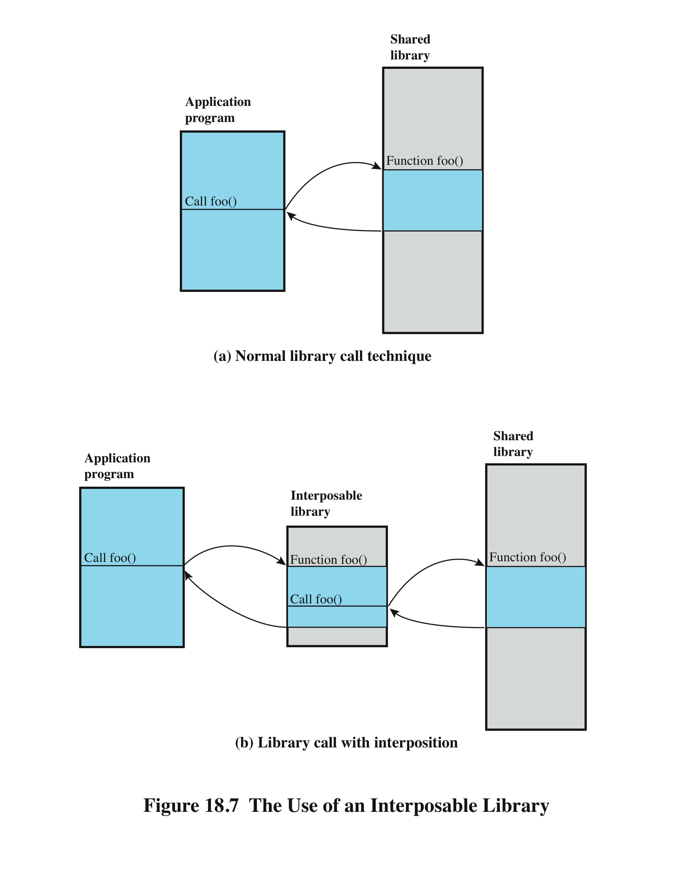
Use of an Interposable Library
Notes:
Figure 18.7a indicates the normal mode of
operation when a program invokes a routine in dynamically linked shared libraries.
At load time, the reference to routine foo in the program is resolved to the virtual
memory address of the start of the foo in the shared library.
With library interpolation, a special interposable library is constructed so that
at load time, the program links to the interposable library instead of the shared
library. For each function in the shared library for which auditing is to be invoked,
the interposable library contains a function with the same name. If the desired
function is not contained in the interposed library, the loader continues its search in
the shared library and links directly with the target function.
The interposed module can perform any auditing-related function, such
as recording the fact of the call, the parameters passed and returned, the return
address in the calling program, and so forth. Typically, the interposed module will
call the actual shared function ( Figure 18.7b ) so that the application’s behavior is
not altered, just instrumented.
This technique allows the interception of certain function calls and the storage
of state between such calls without requiring the recompilation of the calling
program or shared objects.

Slide 27
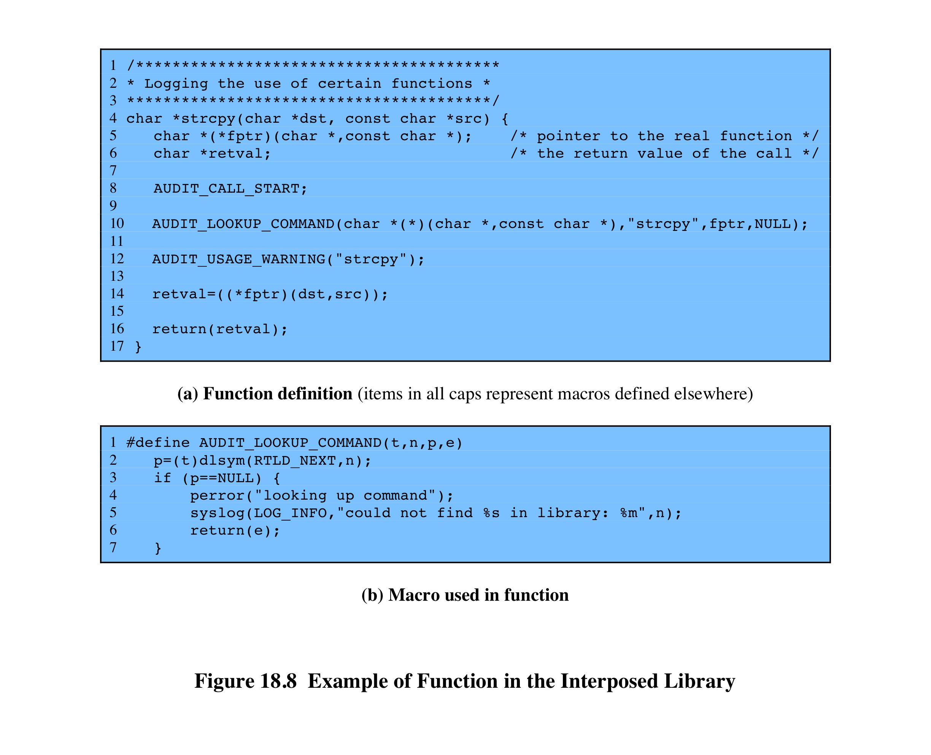
Example of Function in the Interposed Library
Notes:
[KUPE99] gives an example of an interposable library function written in C
( Figure 18.8 ). The function can be described as follows:
1. AUDIT_CALL_START (line 8) is placed at the beginning of every interposed
function. This makes it easy to insert arbitrary initialization code into
each function.
2. AUDIT_LOOKUP_COMMAND (line 10 in Figure 18.8a , detail in
Figure 18.8b ) performs the lookup of the pointer to the next definition of the
function in the shared libraries using the dlsym(3x) command. The special flag
RTLD_NEXT ( Figure 18.8b , line 2), indicates that the next reference along the
library search path used by the run-time loader will be returned. The function
pointer is stored in fptr if a reference is found, or the error value is returned to
the calling program.
3. Line 12 contains the commands that are executed before the function is
called.
4. In this case, the interposed function executes the original function call and
returns the value to the user (line 14). Other possible actions include the
examination, recording, or transformation of the arguments; the prevention
of the actual execution of the library call; and the examination, recording, or
transformation of the return value.
5. Additional code could be inserted before the result is returned (line 16), but
this example has none inserted.

Slide 28
Dynamic Binary Rewriting
can be used with both statically and dynamically linked programs
postcompilation technique that directly changes the binary code of executables
change is made at load time and modifies only the memory image of a program
does not require recompilation of the application binary
implemented on Linux using two modules:
loadable kernel module
monitoring daemon
loadable modules
can be automatically loaded and unloaded on demand
Notes:
The interposition technique is designed to work with dynamically linked shared
libraries. It cannot intercept function calls of statically linked programs unless all
programs in the system are re-linked at the time that the audit library is introduced.
[ZHOU04] describes a technique, referred to as dynamic binary rewriting, that can
be used with both statically and dynamically linked programs.
Dynamic binary rewriting is a postcompilation technique that directly
changes the binary code of executables. The change is made at load time and
modifies only the memory image of a program, not the binary program file on
secondary storage. As with the interposition technique, dynamic binary rewriting
does not require recompilation of the application binary. Audit module selection
is postponed until the application is invoked, allowing for flexible selection of the
auditing configuration.
The technique is implemented on Linux using two modules: a loadable kernel
module and a monitoring daemon. Linux is structured as a collection of modules,
a number of which can be automatically loaded and unloaded on demand. These
relatively independent blocks are referred to as loadable modules [GOYE99].
In essence, a module is an object file whose code can be linked to and unlinked from
the kernel at run time. Typically, a module implements some specific function, such
as a file system, a device driver, or some other feature of the kernel’s upper layer.
A module does not execute as its own process or thread, although it can create
kernel threads for various purposes as necessary. Rather, a module is executed in
kernel mode on behalf of the current process.

Slide 29
Audit Trail Analysis
analysis programs and procedures vary widely
must understand context of log entries
relevant information may reside in other entries in the same logs, other logs, and nonlog sources
audit file formats contain mix of plain text and codes
must decipher manually / automatically
ideally regularly review entries to gain understanding of baseline
Notes:
Programs and procedures for audit trail analysis vary widely, depending on the
system configuration, the areas of most concern, the software available, the security
policy of the organization, and the behavior patterns of legitimate users and
intruders. This section provides some observations concerning audit trail analysis.
To perform useful audit analysis, the analyst or security administrator needs an
understanding of the information available and how it can be used. NIST SP
800-92 [KENT06] offers some useful advice in this regard, which we summarize
in this subsection.
The security administrator (or other individual
reviewing and analyzing logs) needs to understand the context surrounding
individual log entries. Relevant information may reside in other entries in the same
log, entries in other logs, and nonlog sources such as configuration management
entries. The administrator should understand the potential for unreliable entries,
such as from a security package that is known to generate frequent false positives
when looking for malicious activity.
Most audit file formats contain a mixture of plain language plus cryptic messages
or codes that are meaningful to the software vendor but not necessarily to the administrator.
The administrator must make the effort to decipher as much as possible the
information contained in the log entries. In some cases, log analysis software performs
a data reduction task that reduces the burden on the administrator. Still, the administrator
should have a reasonable understanding of the raw data that feeds into analysis
and review software in order to be able to assess the utility of these packages.
The most effective way to gain a solid understanding of log data is to review
and analyze portions of it regularly (e.g., every day). The goal is to eventually gain
an understanding of the baseline of typical log entries, likely encompassing the vast
majority of log entries on the system.
To perform effective reviews and analysis,
administrators should have solid understanding of each of the following from
training or hands-on experience:
• The organization’s policies regarding acceptable use, so that administrators
can recognize violations of the policies.
• The security software used by their hosts, including the types of security related
events that each program can detect and the general detection profile
of each program (e.g., known false positives).
• The operating systems and major applications (e.g., e-mail, Web) used by
their hosts, particularly each OS’s and major application’s security and logging
capabilities and characteristics.
• The characteristics of common attack techniques, especially how the use of
these techniques might be recorded on each system.
• The software needed to perform analysis, such as log viewers, log reduction
scripts, and database query tools.

Slide 30
Types of Audit Trail Analysis
audit trails can be used in multiple ways
this depends in part on when done
possibilities include:
audit trail review after an event
triggered by event to diagnose cause and remediate
focuses on the audit trail entries that are relevant to the specific event
periodic review of audit trail data
review bulk data to identify problems and behavior
real-time audit analysis
part of an intrusion detection function
Notes:
Audit trails can be used in multiple ways. The type of analysis depends, at least in
part, on when the analysis is to be done. The possibilities include the following:
• Audit trail review after an event: This type of review is triggered by an
observed event, such as a known system or application software problem, a
known violation of existing security policy by a user, or some unexplained
system or user problem. The review can gather information to elaborate on
what is known about the event, to diagnose the cause or the problem, and
to suggest remedial action and future countermeasures. This type of review
focuses on the audit trail entries that are relevant to the specific event.
• Periodic review of audit trail data: This type of review looks at all of the audit
trail data or at defined subsets of the data and has many possible objectives.
Examples of objectives include looking for events or patterns that suggest a
security problem, developing a profile of normal behavior and searching for
anomalous behavior, and developing profiles by individual user to maintain a
permanent record by user.
• Real-time audit analysis: Audit analysis tools can also be used in a real-time
or near-real-time fashion. Real-time analysis is part of the intrusion detection
function.

Slide 31
Audit Review
audit review capability provides administrator with information from selected audit records
actions of one or more users
actions on a specific object or resource
all or a specified set of audited exceptions
actions on a specific system / security attribute
may be filtered by time / source / frequency
used to provide system activity baseline
level of security related activity
Notes:
Distinct from an analysis of audit trail data using data reduction and analysis tools
is the concept of audit review. An audit review capability enables an administrator
to read information from selected audit records. The Common Criteria specification
[CCPS04a] calls for a capability that allows prestorage or poststorage audit
selection and includes the ability to selectively review the following:
• The actions of one or more users (e.g., identification, authentication, system
entry, and access control actions)
• The actions performed on a specific object or system resource
• All or a specified set of audited exceptions
• Actions associated with a specific system or security attribute
Audit review can be focused on records that match certain attributes, such as
user or user group, time window, type of record, and so forth.
One automated tool that can be useful in audit review is a prioritization of
audit records based on input from the administrator. Records can be prioritized
based on a combination of factors. Examples include the following:
• Entry type (e.g., message code 103, message class CRITICAL)
• Newness of the entry type (i.e., has this type of entry appeared in the logs
before?)
• Log source
• Source or destination IP address (e.g., source address on a blacklist,
destination address of a critical system, previous events involving a particular
IP address)
• Time of day or day of the week (e.g., an entry might be acceptable during
certain times but not permitted during others)
• Frequency of the entry (e.g., x times in y seconds)
There may be a number of possible purposes for this type of audit review.
Audit review can enable an administrator to get a feel for the current operation of
the system and the profile of the users and applications on the system, the level of
attack activity, and other usage and security-related events. Audit review can be
used to gain an understanding after the fact of an attack incident and the system’s
response to it, leading to changes in software and procedures.

Slide 32
Approaches to Data Analysis
basic alerting
indicate interesting type of event has occurred
baselining
define normal versus unusual events / patterns
compare with new data to detect changes
thresholding is the identification of data that exceed a particular baseline value
windowing
detection of events within a given set of parameters
correlation
seeks relationships among events
Notes:
The spectrum of approaches and algorithms used for audit data analysis is far too
broad to be treated effectively here. Instead, we give a feeling for some of the major
approaches, based on the discussion in [SING04].
BASIC ALERTING The simplest form of an analysis is for the software to give an
indication that a particular interesting event has occurred. If the indication is given
in real time, it can serve as part of an intrusion detection system. For events that
may not rise to the level of triggering an intrusion alert, an after-the-fact indication
of suspicious activity can lead to further analysis.
Baselining is the process of defining normal versus unusual events
and patterns. The process involves measuring a set of known data to compute a
range of normal values. These baseline values can then be compared to new data to
detect unusual shifts. Examples of activity to baseline include the following:
• Amount of network traffic per protocol: total HTTP, e-mail, FTP, and so on.
• Logins/logouts
• Accesses of admin accounts
• Dynamic Host Configuration Protocol (DHCP) address management, DNS
requests
• Total amount of log data per hour/day
• Number of processes running at any time

Slide 33
Integrated Approaches
volume of audit data means manual analysis and baselining is impractical
need a Security Information and Event Management (SIEM) system
a centralized logging and analysis package
agentless or agent-based
normalizes a variety of log formats
analyzes combined data
correlates events among the log entries
identifies and prioritizes significant events
can initiate responses
Notes:
[KELL06] is a report by an information security officer at a government agency on her
attempts to get a handle on the vast amount of security audit data generated by her
agency’s networks, servers, and hosts. The systems are configured to generate audit
data, including security-related audit data, for management, auditors, and attorneys.
So much data is generated that it makes it difficult for the security officer to extract
timely and useful information. She needs to get and analyze security-related data
from hosts, servers, routers, intrusion detection systems, firewalls, and a multitude of
other security tools. The load is so great that one large server is dedicated solely to
housing security analysis software and audit files.
The problem came to a head when the security officer realized that it had
become impossible to perform one of the basic tasks of security audit analysis:
baselining. The security officer needs to be able to characterize normal activity
and thresholds so that the system will generate alerts when anomalies or malicious
patterns are detected. Because of the volume of data, a human-generated or
even human-assisted baseline generation was impractical. And with the broad mix
of audit data sources and formats, there seemed to be no obvious way to develop
automated baseline generation.
The type of product that can address these issues has been referred to
as a security information management (SIM) system or a security information
and event management (SIEM) system. As these products move into the third
and fourth generations, a number of other names have proliferated, with none
commonly accepted across product lines. Before looking at the specific solution
adopted by this security officer, we provide a brief general overview of SIEM
systems.

Slide 34
Example: Cisco MARS
example of SIEM product
support a wide variety of systems
agentless with central dedicated server
wide array of analysis packages
an effective GUI
server collects, parses, normalizes, correlates and assesses events to then check for false positives, vulnerabilities, and profiling
Notes:
After reviewing several alternatives, the security officer chose the Cisco Systems’ MARS
product as being the most cost-effective. The MARS product supports a variety of
systems. Of course, all of the Cisco products on site were compatible with the product,
including NetFlow and syslog data from Cisco routers, firewalls, switches, concentrators,
IDSs, and so on. In addition, MARS can pull data from almost any SNMP- and
syslog-enabled device, as well as from a wide range of vulnerability and antivirus systems,
host operating systems, Web servers, Web proxy devices, and database servers. The
following is a list of the devices and software packages supported at that time by MARS:
• Network: Cisco IOS Software; Cisco Catalyst OS; Cisco NetFlow; and Extreme
Extremeware
• Firewall/VPN: Cisco ASA Software; Cisco PIX Security Appliance; Cisco
IOS Firewall; Cisco Firewall Services Module (FWSM); Cisco VPN 3000
Concentrator; Checkpoint Firewall-1 NG and VPN-1 versions; NetScreen
Firewall; and Nokia Firewall
• Intrusion detection: Cisco IDS; Cisco IDS Module; Cisco IOS IPS; Enterasys
Dragon NIDS; ISS RealSecure Network Sensor; Snort NIDS; McAfee
Intrushield NIDS; NetScreen IDP; OS; and Symantec ManHunt
• Vulnerability assessment: eEye REM, Qualys QualysGuard, and FoundStone
FoundScan
• Host security: Cisco Security Agent; McAfee Entercept; and ISS RealSecure
Host Sensor
• Antivirus: Symantec Antivirus, Cisco Incident Control System (Cisco ICS),
Trend Micro Outbreak Prevention Service (OPS), Network Associates
VirusScan, and McAfee ePO
• Authentication servers: Cisco Secure ACS
• Host log: Windows NT, 2000, and 2003 (agent and agentless); Solaris; and Linux
• Application: Web servers (Internet Information Server, iPlanet, and Apache);
Oracle audit logs; and Network Appliance NetCache
• Universal device support: To aggregate and monitor any application syslog
MARS works in an agentless configuration, with a centralized dedicated
server. In general terms, the server performs the following steps:
1. Events come into the MARS server from devices and software modules
throughout the network.
2. Events are parsed to locate and identify each field in the entry.
3. MARS normalizes each entry into a uniform audit trail entry format.
4. MARS performs a correlation function to find events that are related and
defines sessions. Each session is a related set of events. For example, if a worm
is detected, the detected occurrences across all devices are correlated into a
single session for this worm attack.
5. Sessions and uncorrelated events are run against a rule engine and each is
assessed. Some events and sessions are dropped as irrelevant. The others are
reclassified as incidents to be logged in the incident database.
6. A false-positive analysis is run on the data to catch known false positive
reports for IDS and other systems in the network.
7. A vulnerability assessment is performed against suspected hosts to determine
the urgency of the data.
8. Traffic profiling and statistical anomaly detection programs are run against
the data.
MARS provides a wide array of analysis packages and an effective graphical
user interface. Preliminary indications are that this product will meet the needs of
the security officer.

Slide 35
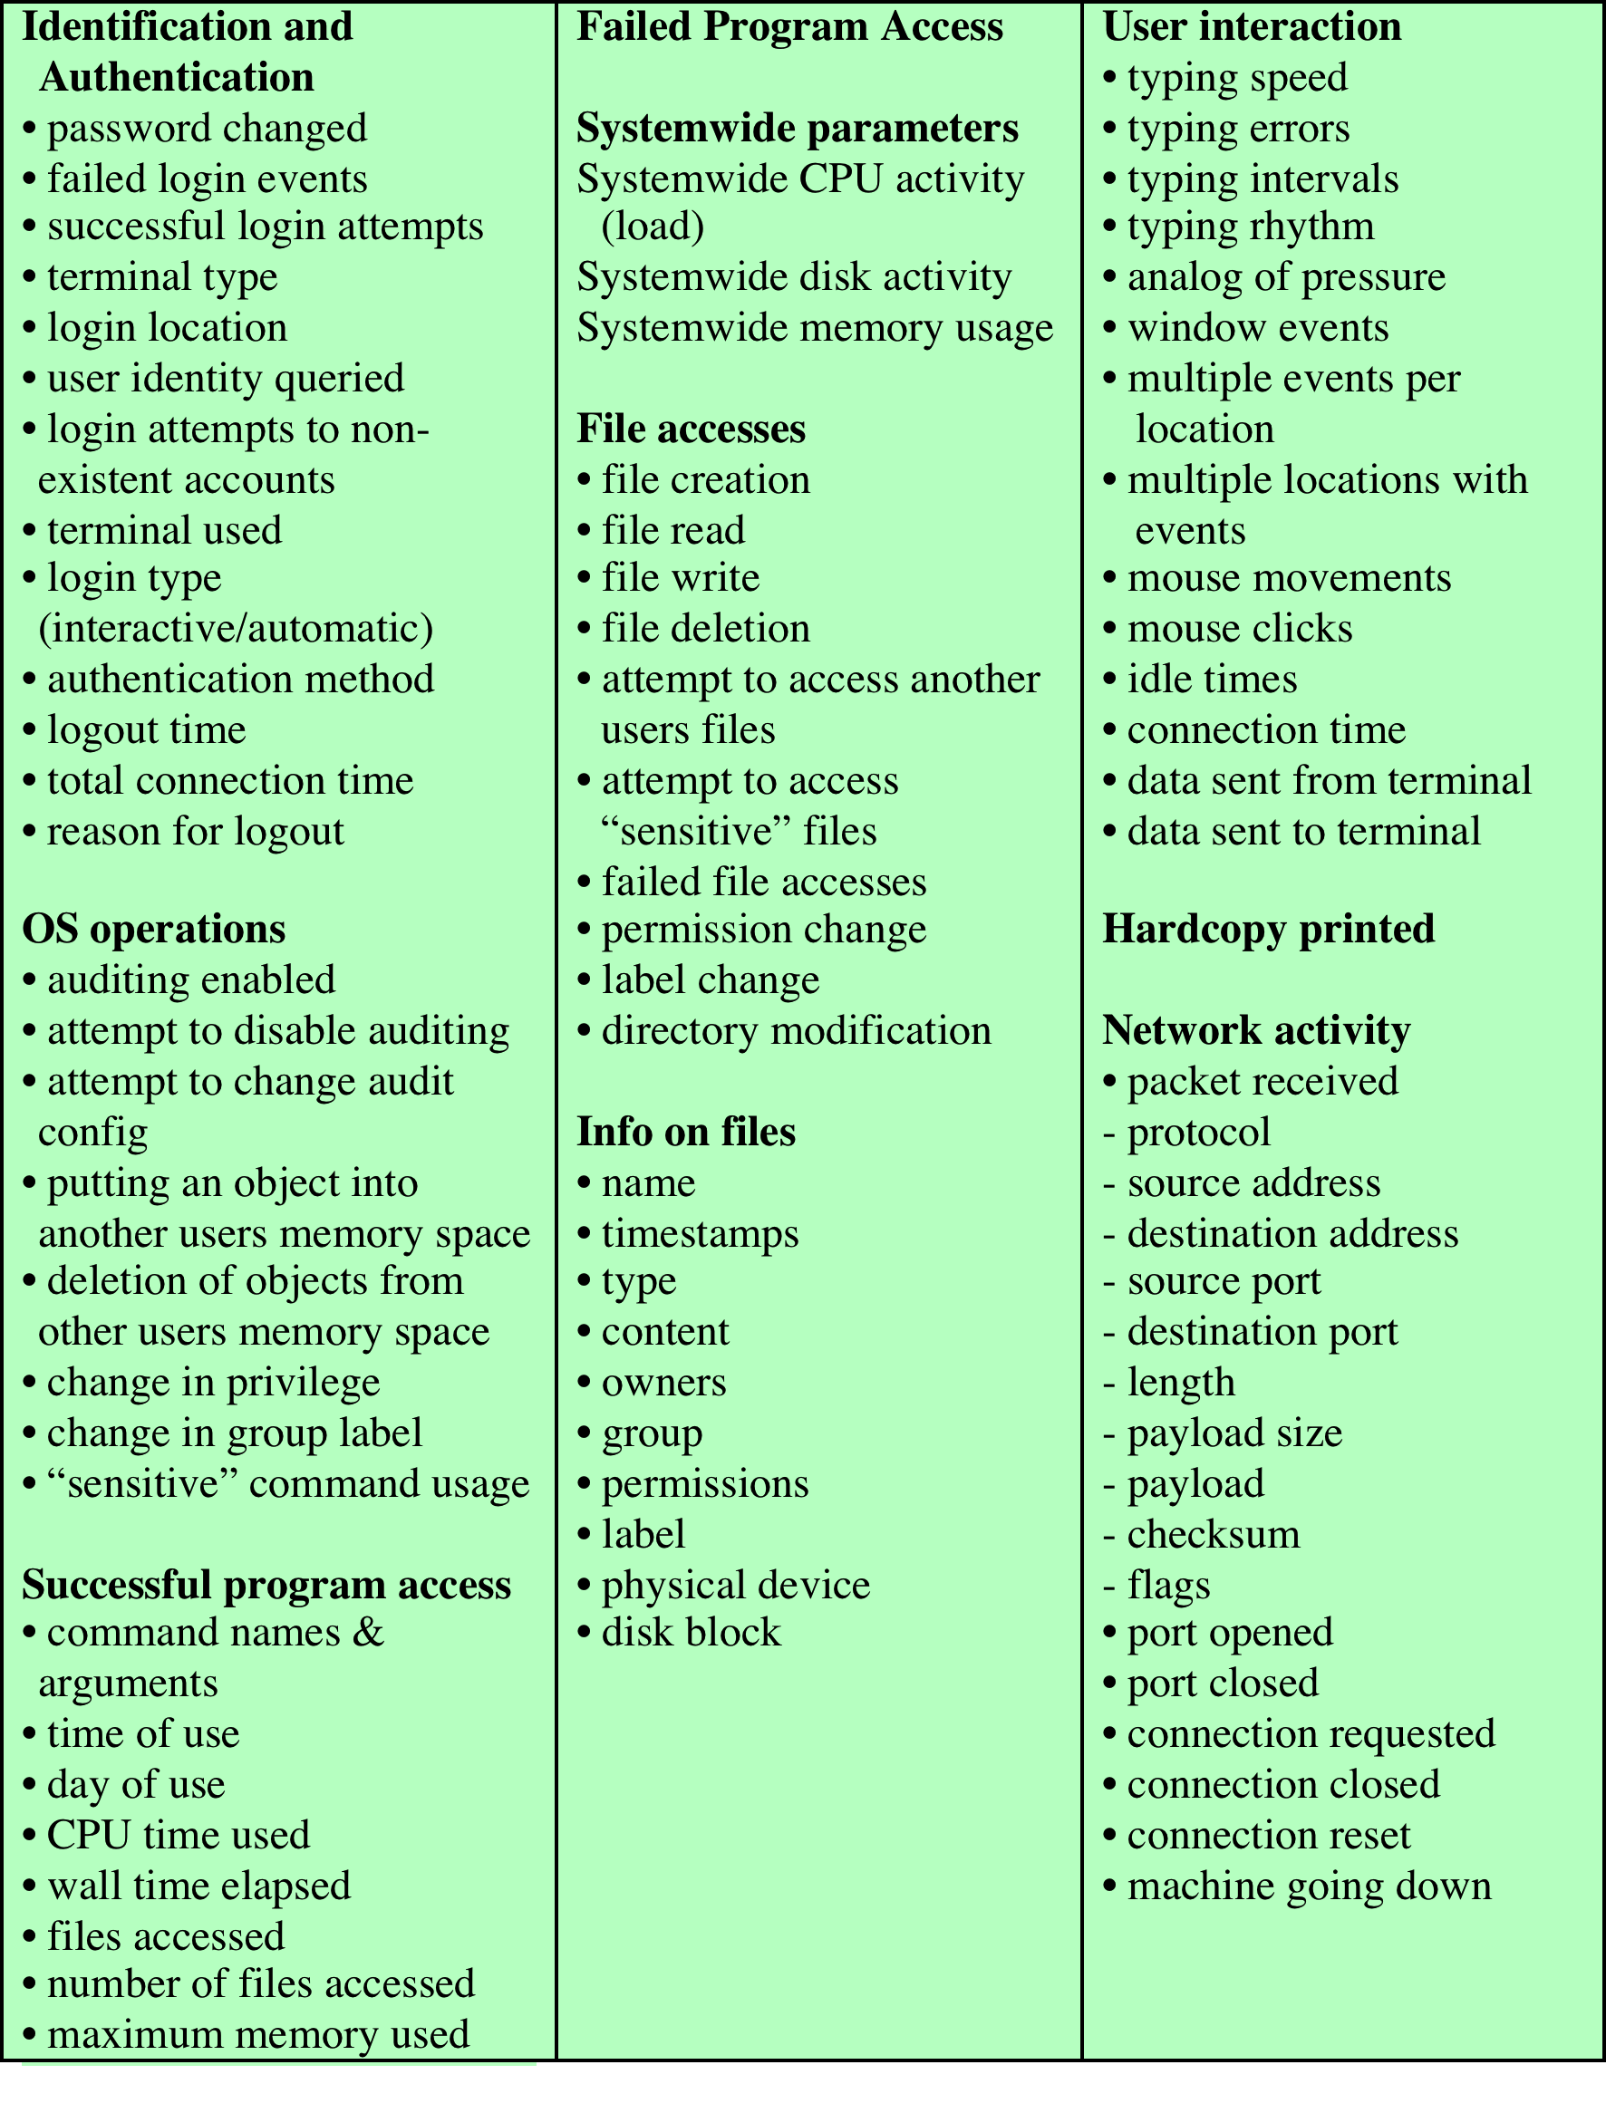
Table 18.6 Suggested List of Events to Be Audited
Notes:
Table 18.6
Suggested list of events to be audited.

